Slide 1
ASE 239
Presentation Assignment

Slide 2
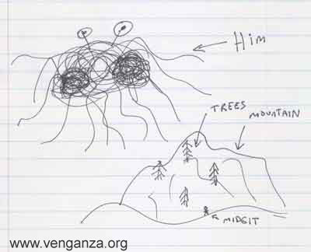
Part 1 – Picture 1

Slide 3
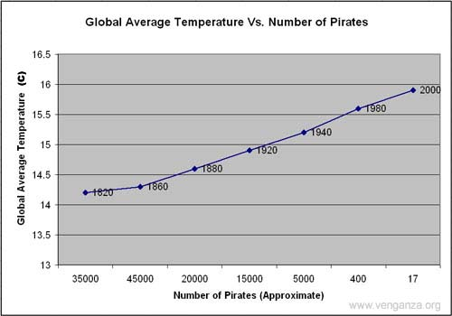
Part 1 – Picture 2

Slide 4
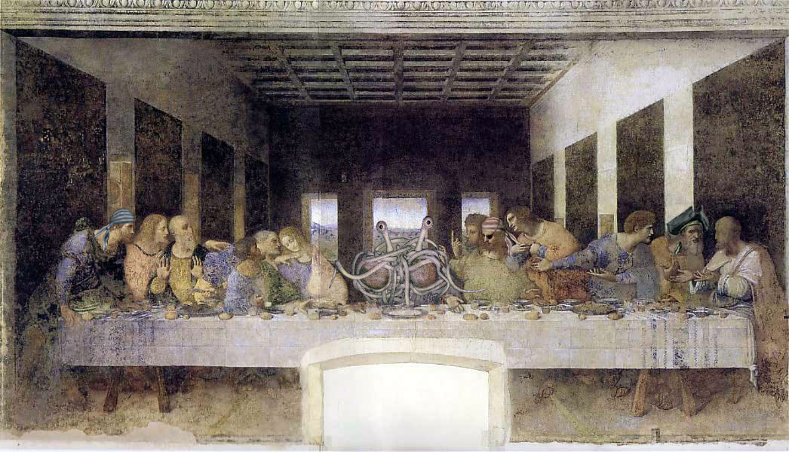
Part 1 – Picture 3

Slide 5
Part 2 – Audience Description

Slide 6
Part 3 – Add Headings to Your Presentation
You can review the headings by switching to Outline view on the left
Submit this PowerPoint with the headings for your completed presentation

Slide 7
Part 4 – Complete the assignment
Add content to the slides that you have created headings for
Arrange the slides and graphics in a logical order
Apply a Slide Design (Format – Slide Design and select a suitable slide template)

Slide 8
Citations and References
Slide 2 & 3 images:
  Henderson, Bobby. "Open Letter To Kansas School Board." Church of the Flying Spaghetti Monster. 14 Sept 2006. 9 Nov 2006 <http://www.venganza.org/about/open-letter/>.
Slide 4 image:
  9 Nov 2006 <http://www.venganza.org/images/wallpapers/Last-Supper.jpg>.

